Slide 1

WIPRO NGA Program – DWS
Capstone Project Presentation – 17th June & 18ᵗʰ June 2025
Project Title Here - Convert MSI to MSIX using MSIX Packaging Tool. Migrate a . Traditional MSI app to MSIX Format
Presented by - 28945 - Pravin Adde
www.rpsconsulting.in

Slide 2
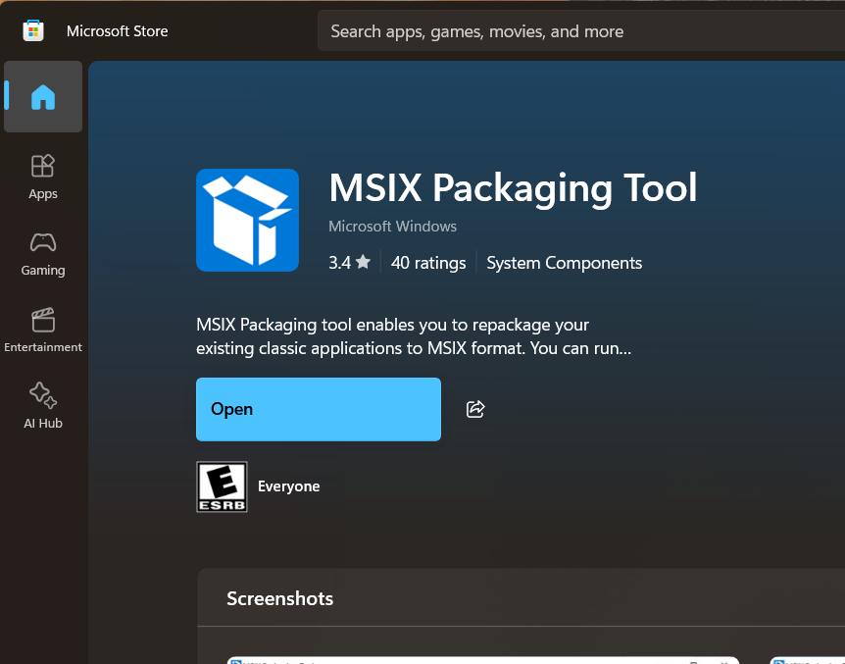

Convert MSI to MSIX using MSIX Packaging Tool. Migrate a Traditional MSI app to MSIX Format
This project report provides a comprehensive overview of the process involved in converting traditional MSI applications to the MSIX format utilizing the MSIX Packaging Tool. It outlines necessary prerequisites, detailed procedures, and the final output of the conversion, ensuring that application security is maintained while simplifying the deployment process for end-users.
2
2024 - RPS Consulting all rights reserved

Slide 3
Overview of the Project to Convert MSI to MSIX
Application Security Focus
Enhanced User Experience
Ensuring the security and integrity of applications during the conversion process is paramount. This involves verifying that applications are compliant with current security standards to protect user data and maintain trust.
By migrating to MSIX, end-users benefit from a smoother installation and update experience. This transition minimizes disruptions and enhances overall user satisfaction with the application.
Simplified Deployment Process
Robust Update Mechanism
The project aims to create a simplified deployment process for applications. This includes reducing installation complexity and enhancing the management of updates, making it easier for IT teams to handle deployments.
The project will implement a robust update mechanism that allows for seamless updates without requiring user intervention. This ensures users always have the latest features and security patches.
MSIX Packaging Standards Compliance
Cost Efficiency in Management
Transitioning to MSIX ensures compliance with modern packaging standards, allowing applications to take advantage of new features and improvements over traditional MSI formats, thus future-proofing them.
Switching to MSIX can lead to cost efficiencies in application management. Simplified updates and deployment processes reduce the need for extensive IT resources, leading to lower operational costs.
2
2024 - RPS Consulting all rights reserved

Slide 4




Introduction to MSIX Packaging Tool
Convert desktop applications to MSIX format
The MSIX Packaging Tool enables the transformation of existing desktop applications into the MSIX app package format for streamlined management.
Simplifies application repackaging
With MSIX, the repackaging process becomes less complex, allowing for more efficient application deployment.
Easier deployment on Windows devices
MSIX facilitates smoother deployment and management of applications across various Windows devices.
2024 - RPS Consulting all rights reserved

Slide 5
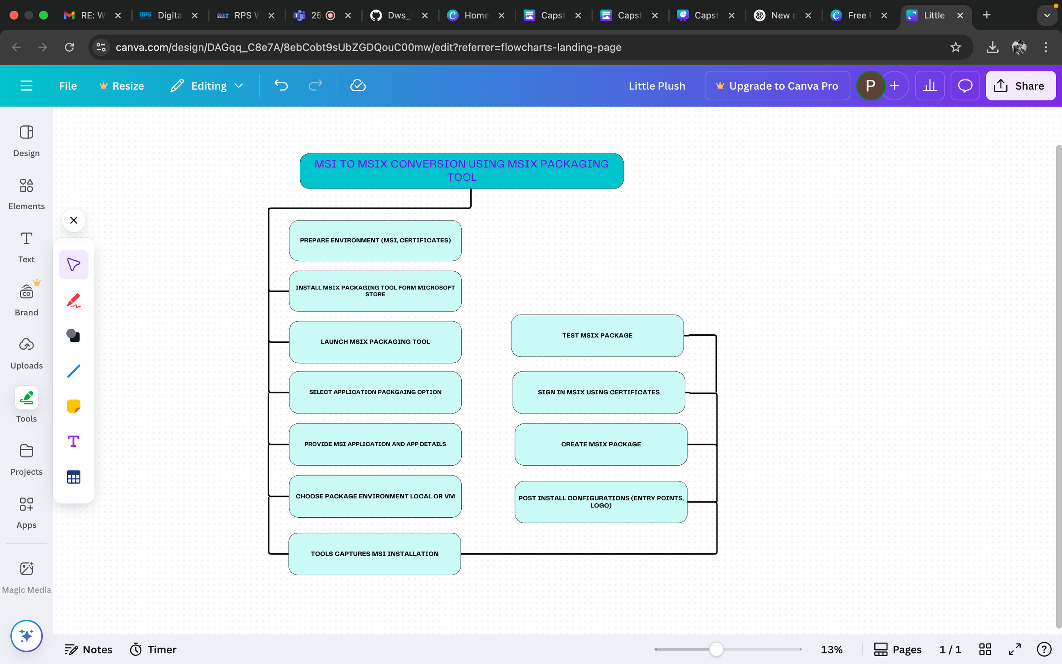

Slide 6

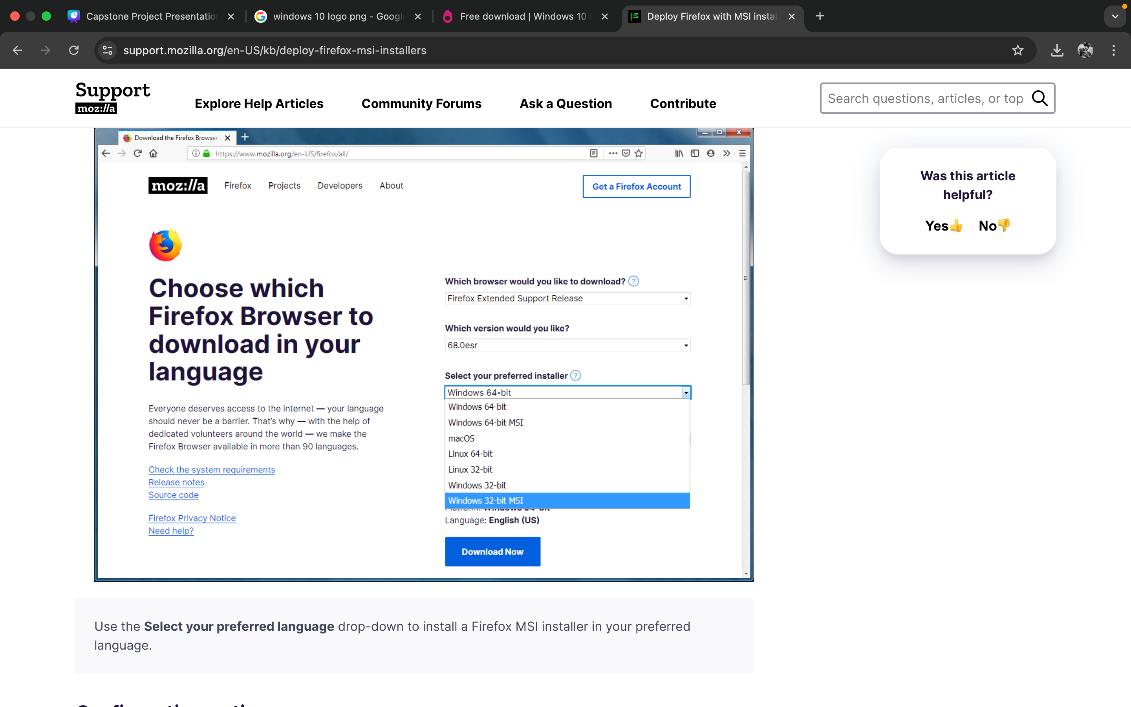

Essential Prerequisites for MSIX Conversion
Key requirements for converting MSI to MSIX using MSIX Packaging Tool
Windows 10 version 1809 or later
Install the MSIX Packaging Tool
Provide an .msi file for conversion
Signing certificate
2024 - RPS Consulting all rights reserved

Slide 7

Download MSIX Packaging Tool
Download Tool
Install Tool
Launch Application
Check Compatibility
Support Resources
Visit the Microsoft Store to download the MSIX Packaging Tool which is essential for the conversion process.
Once downloaded, proceed with the installation of the MSIX Packaging Tool on your computer to prepare for use.
After installation is complete, click on Open to initiate the MSIX Packaging Tool and start the conversion process.
Ensure that your system meets the requirements for the MSIX Packaging Tool to function effectively during the conversion.
Utilize available resources and documentation for guidance on using the MSIX Packaging Tool efficiently during conversions.
2024 - RPS Consulting all rights reserved

Slide 8
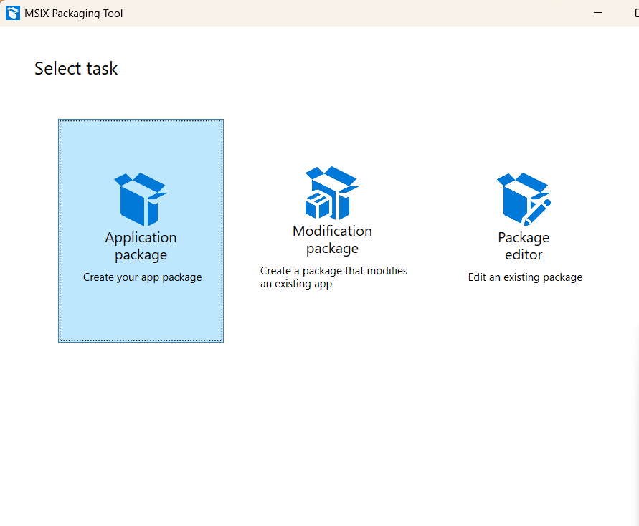
Selecting the Conversion Option for MSIX
Choose the Conversion Option
Select "Application package" on the welcome screen
Click on "Create Your app Package .
This is the very First Step in MSIX Package creation. Where we do have another options like
Modify Package
Package Editor
2024 - RPS Consulting all rights reserved

Slide 9
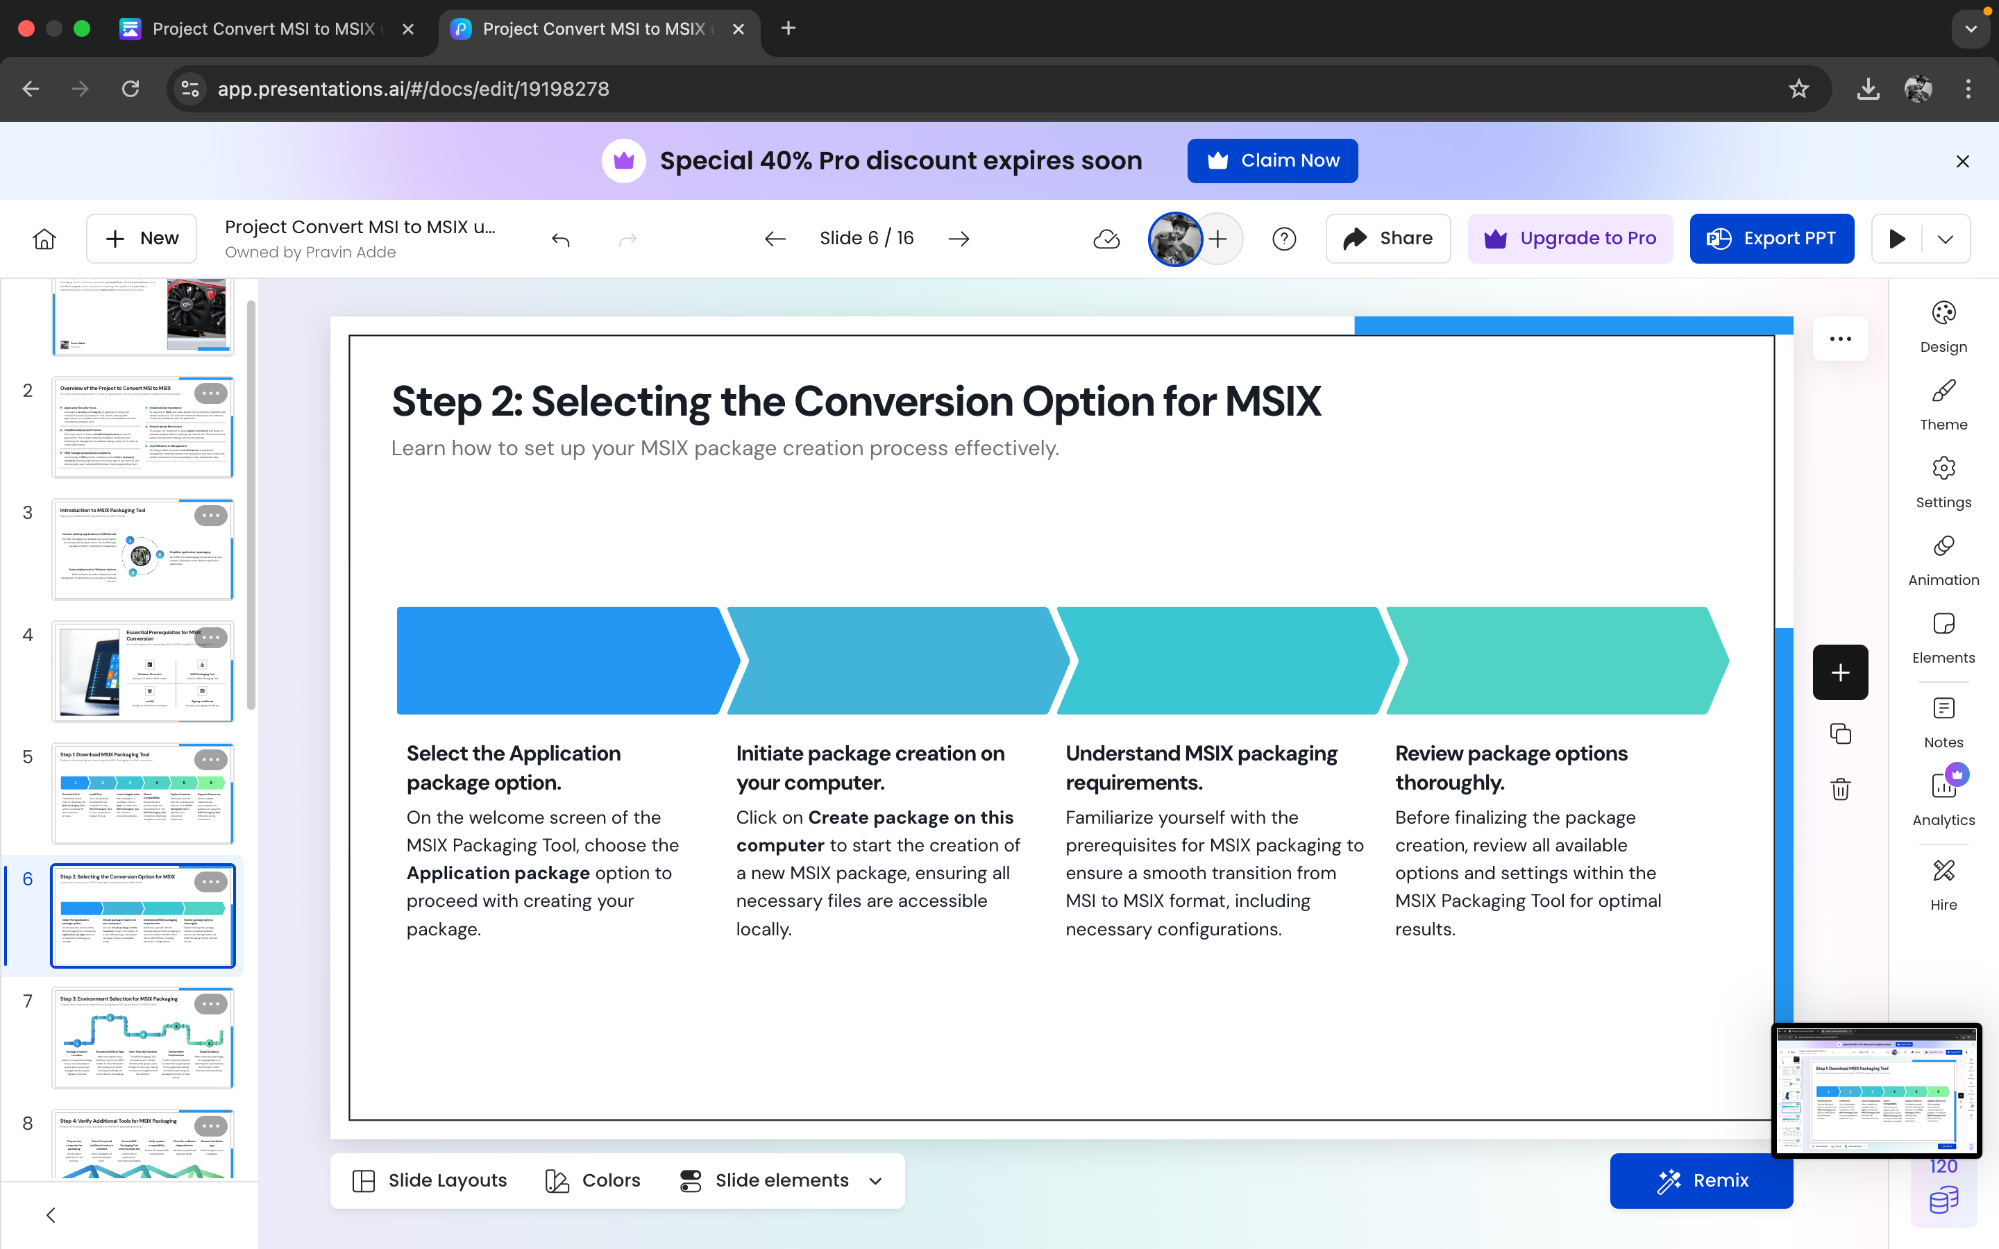
Selecting the Conversion Option for MSIX
Select the Application package option.
Initiate package creation on your computer.
Understand MSIX packaging requirements.
Review package options thoroughly.
On the welcome screen of the MSIX Packaging Tool, choose the Application package option to proceed with creating your package.
Click on Create package on this computer to start the creation of a new MSIX package, ensuring all necessary files are accessible locally.
Familiarize yourself with the prerequisites for MSIX packaging to ensure a smooth transition from MSI to MSIX format, including necessary configurations.
Before finalizing the package creation, review all available options and settings within the MSIX Packaging Tool for optimal results.
2024 - RPS Consulting all rights reserved

Slide 10
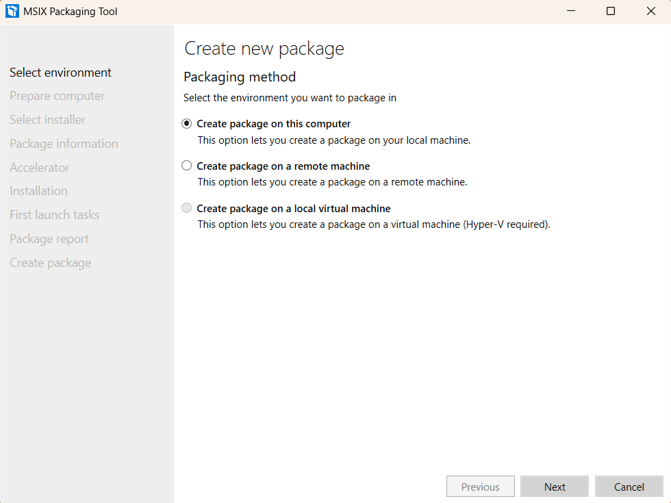
Selecting the Conversion Option for MSIX
Select the environment we want our package to be
In this case we are going to choose to
Create the package on our local Machine
To move on to the next step
Click on the NEXT button
We then click on the NEXT button to move forward
2024 - RPS Consulting all rights reserved

Slide 11
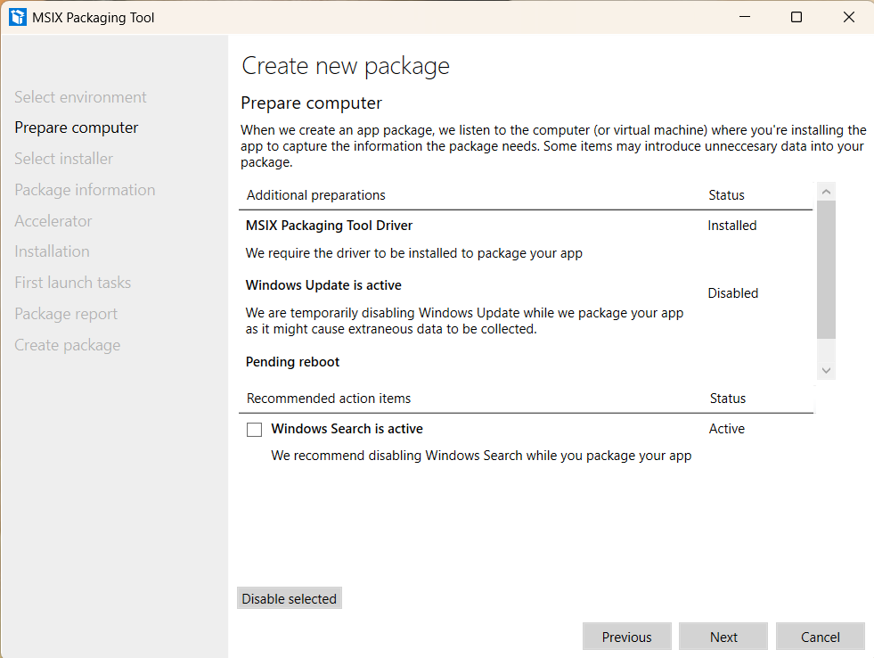
Prepare the Computer for Packaging and Check if required additional tools are required.
1)Check MSIX Packaging Tool Driver
In this case MSIX Packaging Tool Driver is Checked and Detected as installed
2) Automated Procedures
??
Windows Update: Disabled temporarily (Work in progress...)
?Reason: Prevents package integrity from being impacted by irrelevant updates. ?
2024 - RPS Consulting all rights reserved

Slide 12
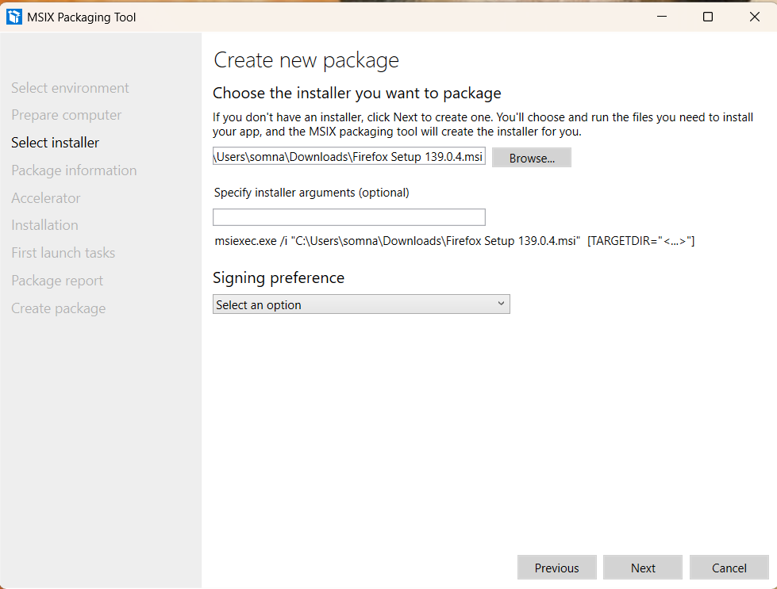
Select Installer
Installer Selection
Choose the installer file.
Here we have to choose the .msi installer file that to be converted into MSIX .
Use the Browse button and select the .msi file
In this case I have used Firefox Setup 139.0.4.msi file
The MSIX Packaging Tool captures the installation process automatically, so it must be able to run your installer without user interaction.
2024 - RPS Consulting all rights reserved

Slide 13
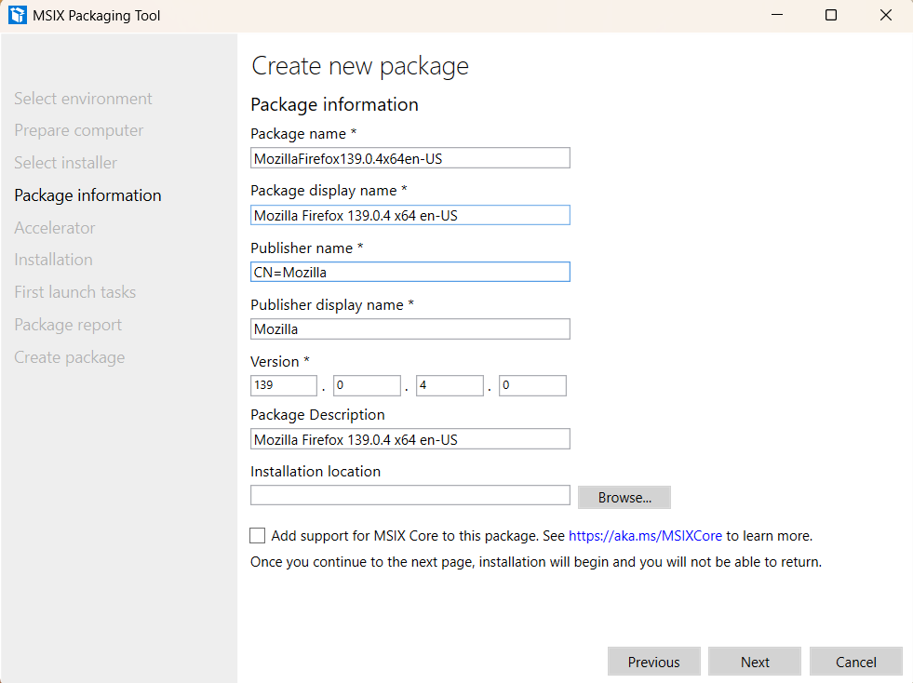
Specify Package Information
The tool may ask you to provide:
Package Name
Publisher Name (should match your certificate). (CN=Publisher Name)
Version. (139.0.4.0)
Display Name
Logo (optional)
2024 - RPS Consulting all rights reserved

Slide 14
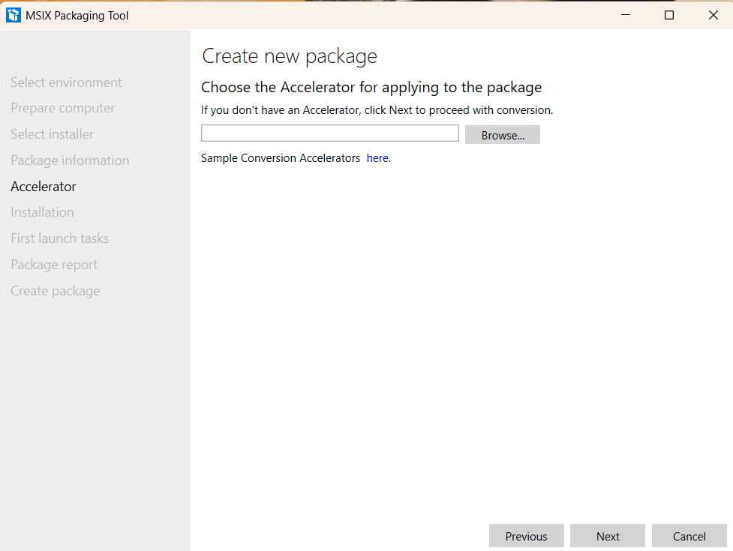
Choose an Accelator
The Accelerator is a template or pre-configured package configuration that helps speed up the repackaging process and standardize MSIX package creation across teams or projects.
Purpose of Accelerator
The Accelerator feature is designed to:
Reduce manual input during packaging
Enforce consistency (e.g., naming, capabilities, entries)
Save time for repeated conversions or large-scale deployments
We haven’t Specified any Accelerator as we dont have any specific Accelerator file
2024 - RPS Consulting all rights reserved

Slide 15
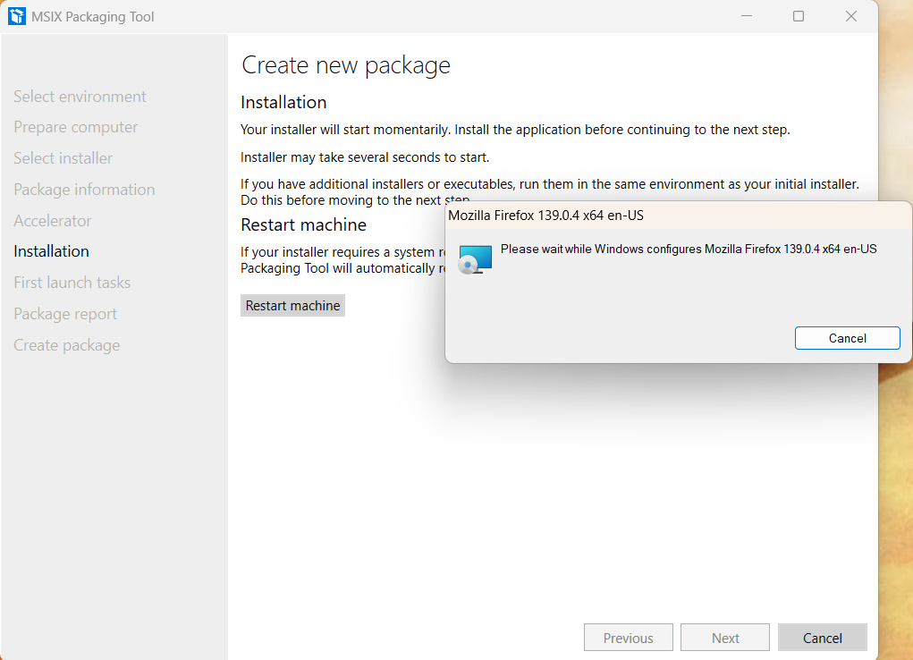
Installation
This step monitors and records the changes made to the system while your MSI or EXE installer is running, including:
Files created or modified
Registry entries added or changed
Shortcuts created
Services installed
Application binaries and dependencies
2024 - RPS Consulting all rights reserved

Slide 16
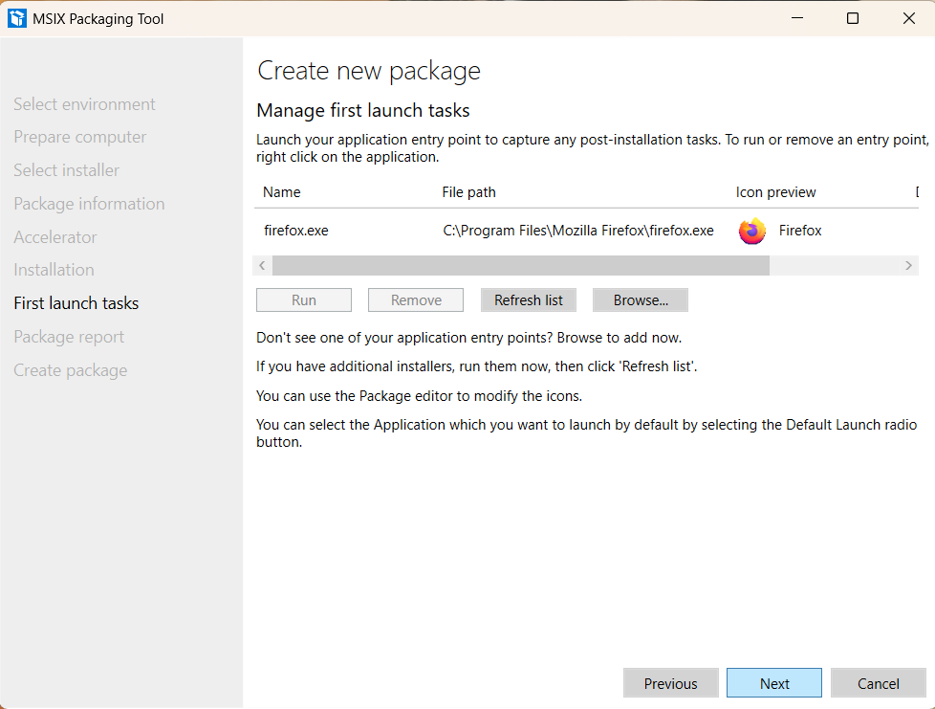
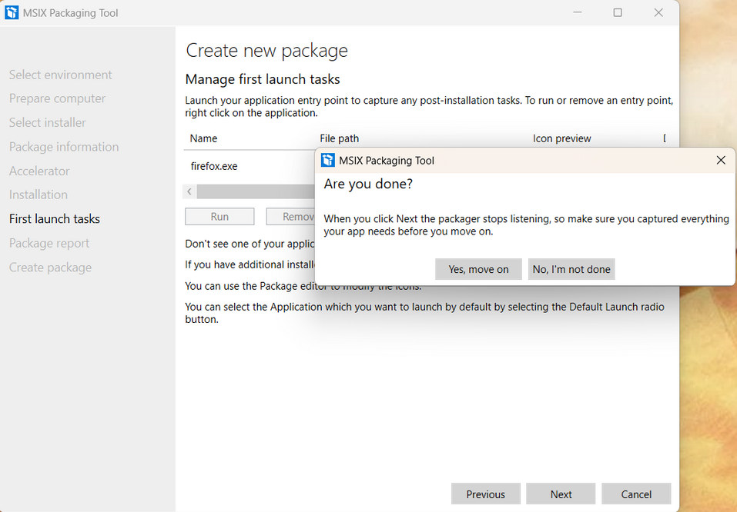
First Launch Tasks
Many applications perform important tasks after installation but before first use, such as:
Creating configuration files
Registering user-specific settings
Downloading components
Initializing databases
Setting up plugins or extensions
The MSIX Packaging Tool can capture these changes and include them in the MSIX package to ensure the app is ready to use immediately after deployment.
2024 - RPS Consulting all rights reserved

Slide 17
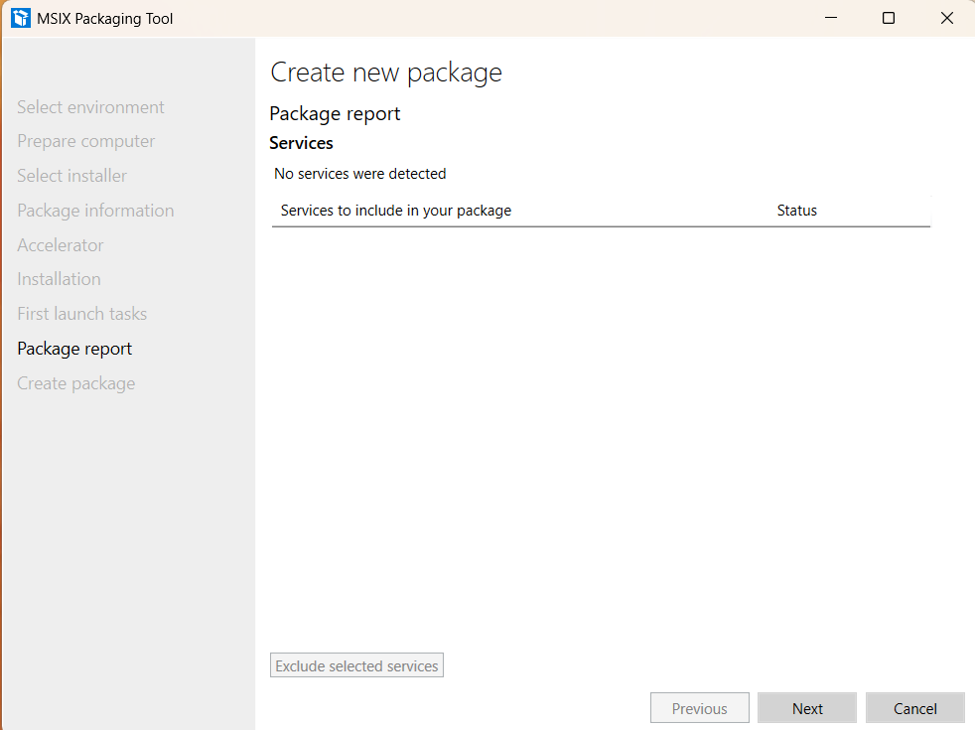
Package Report
The Services section
displays Windows Services that your application installs or depends on. MSIX has limited support for services, so this section helps manage how services are treated during packaging.
Included services—None currently listed.
2024 - RPS Consulting all rights reserved

Slide 18
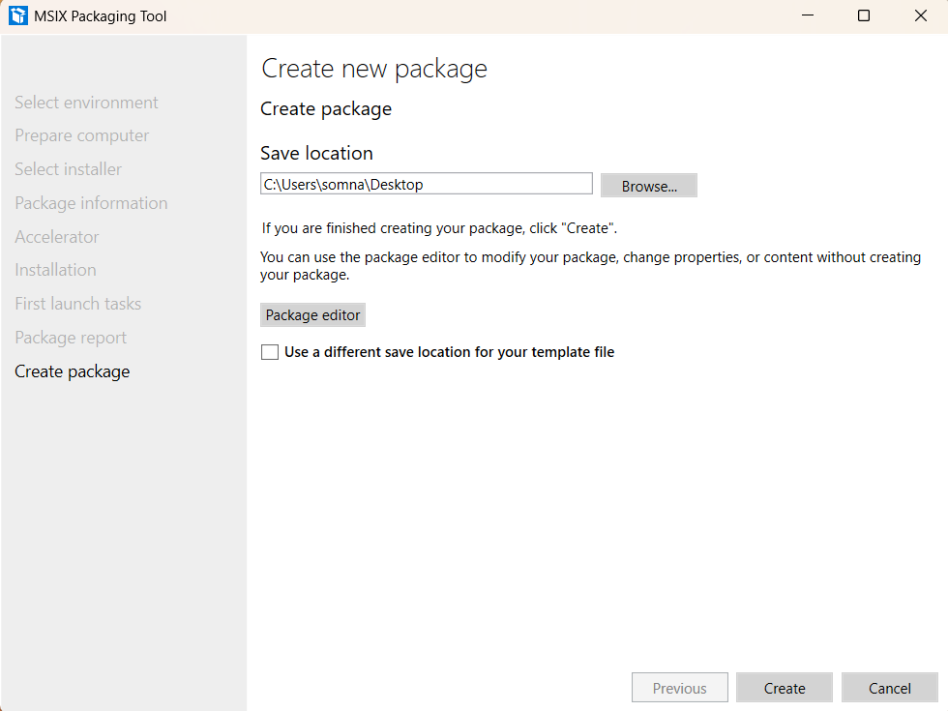
Create New Package
Now we have moved to the final step that says create a Package
Save Location Selection:
Allows users to specify the folder where the packaged application will be saved.
Package Editor
Still makes us enable to edit new Package
Action Buttons:
Provides Back, Create, and Cancel options to finalize the packaging process.
2024 - RPS Consulting all rights reserved

Slide 19
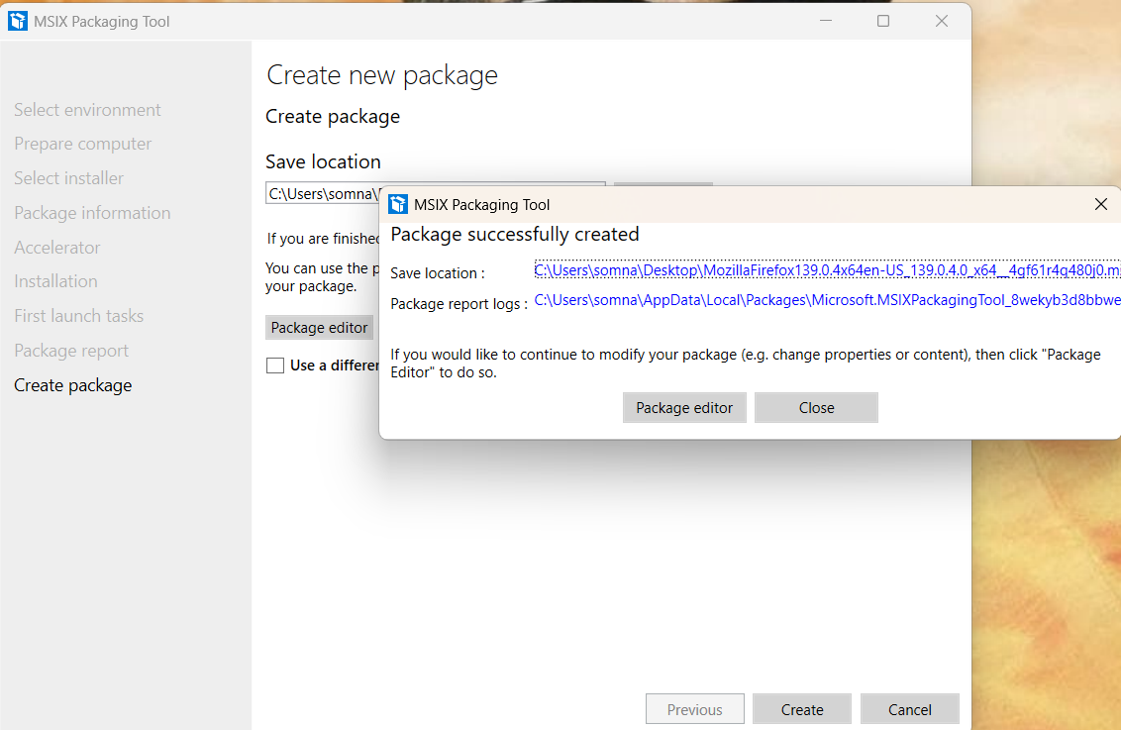
Package Successfully Created
Here the MSIX Package is successfully Created
Save Location Selection:
This displays where the .MSIX converted Package is stored.
Package Report Logs
This location hold the reports and log files for the .MSIX files
Press the CLOSE Option and Check for the .MSIX file in the Target Location.
2024 - RPS Consulting all rights reserved

Slide 20
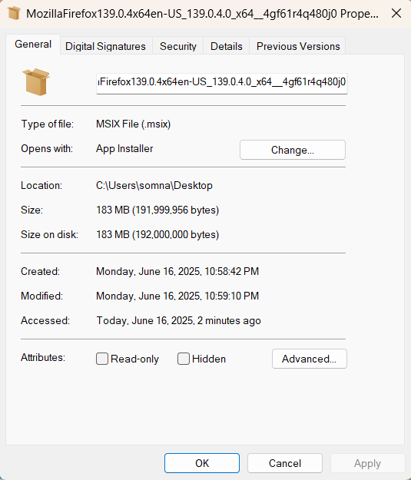
Output
We Now have our .MSIX file Generated at the Targeted Location
C:\Users\Somna\Desktop\MozillaFirefox.msix
2024 - RPS Consulting all rights reserved

Slide 21
Thank You!!
2024 - RPS Consulting all rights reserved

